Slide 1

Techniques for Automatic Device Identification and Network Assignment

Slide 2


INTRODUCTION
What is IoT?
IoT connects devices to the internet, enabling them to communicate and automate tasks.
Why is it needed?
It simplifies daily life, boosts efficiency, and drives innovation.
Where is it used?
From smart homes and healthcare to industrial automation and agriculture.
Rapid IoT Expansion
Over 14 billion devices today, projected to surpass 29 billion by 2030.

Slide 3
DISCUSSION POINTS
Identification of Challenges
What Should Be Prioritized
Framework-PHASES
Solutions and Metrics to measure success
Observations and Expected outcomes

Slide 4

IDENTIFICATION OF CHALLENGES
Physical Security Issues: Devices are often left unprotected, making them easy targets for tampering.
Weak Encryption or No Encryption: Sensitive data is stored or transmitted insecurely, risking exposure.
Device Management Struggles: Difficulty in tracking, monitoring, and patching large IoT ecosystems.
Botnet Vulnerability: Compromised devices can be turned into malicious nodes for large-scale attacks.

Slide 5
MITIGATION STRATEGIES
Physical Security: Employ tamper-evident seals, secure enclosures, and restrict physical access.
Strong Encryption: Use robust protocols for data at rest and in transit; rotate keys regularly.
Device Management Solutions: Implement centralized systems for health tracking, patching, and updates.
Network Segmentation: Update firmware, enforce strong credentials, and isolate IoT networks to reduce risks.

Slide 6
WHAT TO PRIORITIZE?
Identify Risky Devices: Focus on unmanaged, unknown, or high-risk devices.
Build Accurate Inventories: Categorize devices based on compliance and risk levels.
Apply Zero Trust Principles: Ensure device validation and isolation.
Improve Monitoring Tools: Use AI and telemetry to track and analyze devices.
Enhance Compliance: Regularly review and update security and compliance programs.
Strengthen Vulnerability Management: Patch devices, secure credentials, and prevent exploits.

Slide 7
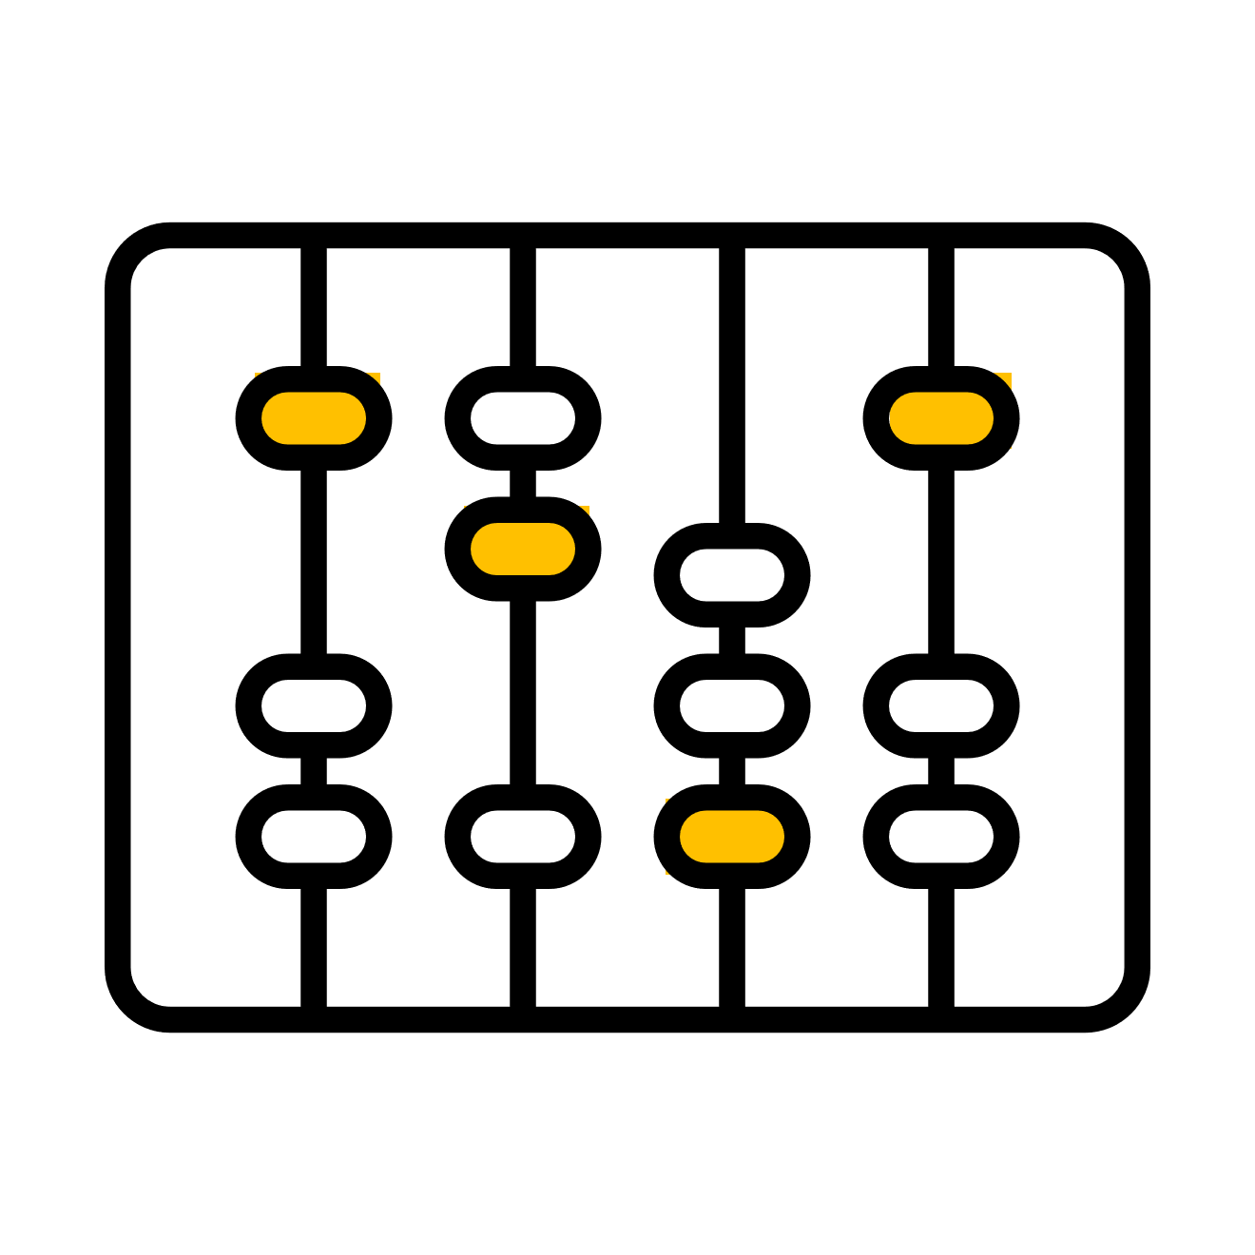

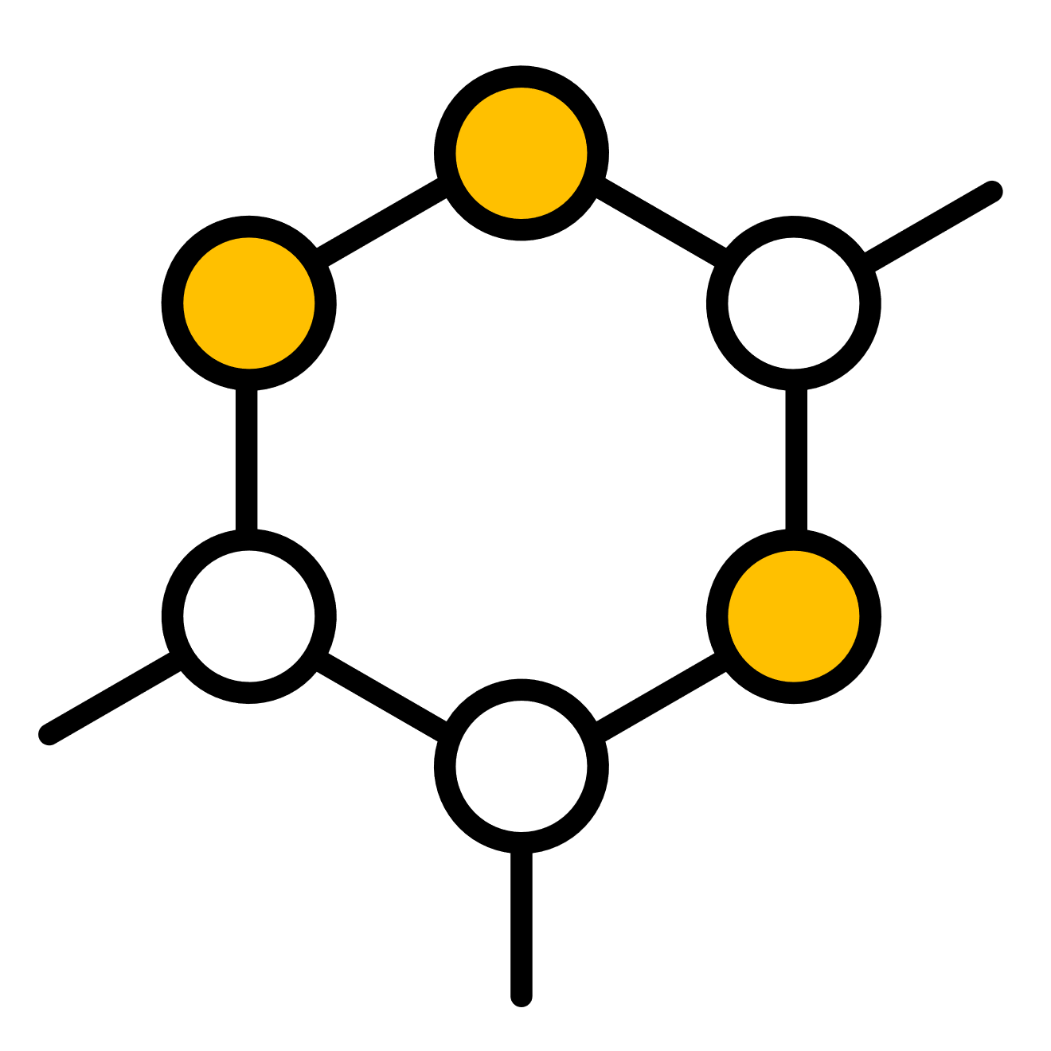

FRAMEWORK -PHASES
DISCOVERY
Gather data about connected devices, validate inventory, and identify new deployments.
CONSULTING
ASSESSMENT
ONBOARDING
Align risks, classify IoT devices, and use AI for analysis and predictions
Categorize devices, validate against policies, and ensure compliance
Implement self-registration portals, Zero Trust controls, and remediation systems

Slide 8

SOLUTIONS
Unmanaged Devices: Use tools for automatic device discovery and maintain a centralized inventory.
IoT Security: Regular updates, unique passwords, strong encryption, and network segmentation.
Unknown Devices: Validate devices with conditional access before granting network permissions.
Overwhelmed Monitoring: Implement AI-driven tools to handle traffic and device variety.
Telemetry Reporting: Analyze real-time data from devices to enhance risk detection and security improvements.

Slide 9
OBSERVATIONS AND EXPECTED OUTCOMES
Unmanaged/unknown devices create security risks and data breaches.
Weak IoT security increases vulnerability.
Traditional monitoring systems can't handle the growing number of devices.
No telemetry reporting makes threat detection difficult.
Expected Outcomes:
Better device visibility with automated discovery.
Stronger IoT security through updates and encryption.
Improved access control with Zero Trust.
AI-powered monitoring for efficient tracking.
Faster threat detection through real-time reporting.
Reduced incident response time with automated alerts and effective monitoring.

Slide 10

Thank you
ANY QUESTIONS?
GROUP MEMBERS:
Masooma Hassan 22K4749
Muhammad Haris 22K4752
Muhammad Abdullah 22K4712

